Slide 1
Nuclease Assays
Supplementary

Slide 2
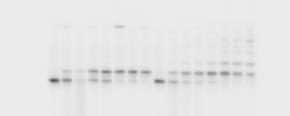
Suppl. Fig. 6B
ssRNA
RNA*-DNA
5’
5’
- 2 5 10 15 30 45 60 - 2 5 10 15 30 45 60 Time (min)
Radiolabelled

Slide 3
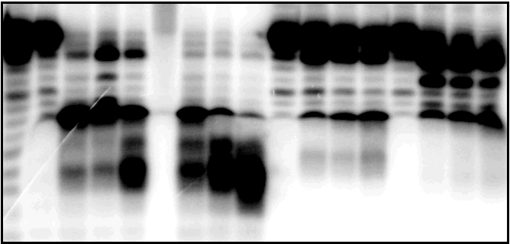
Suppl. Fig. 6A
Ladder
25mer
23mer
20mer
19mer
18mer
17mer
16mer
15mer
14mer
13mer
12mer
Radiolabelled

Slide 4
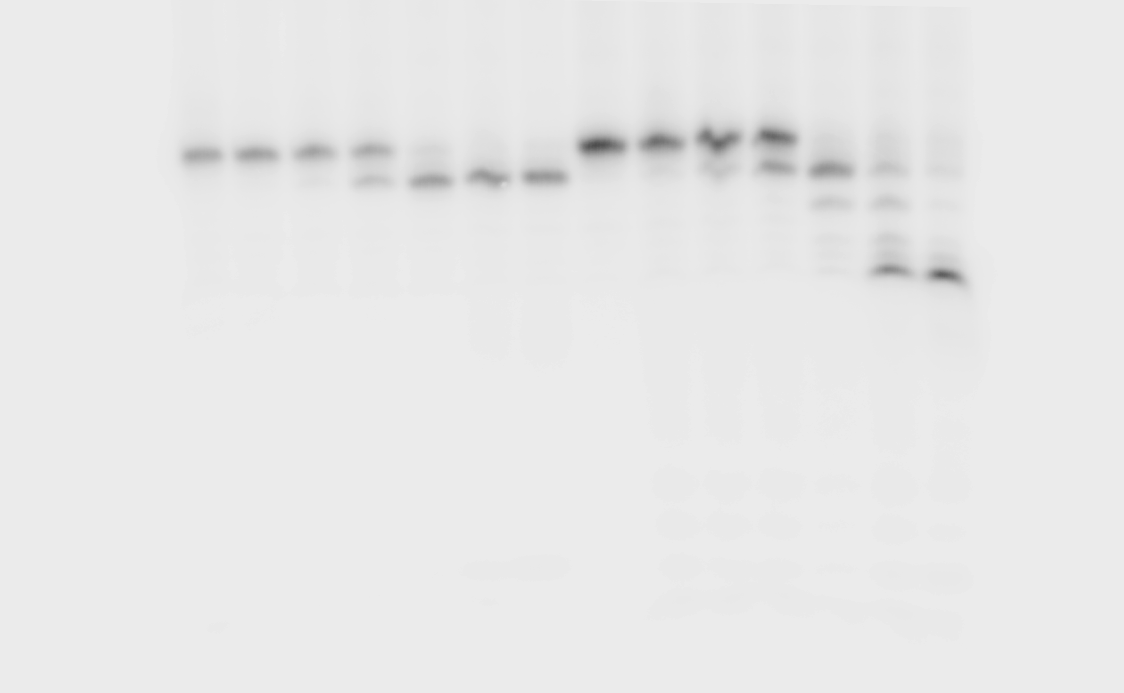
Suppl. Fig. 6A
ssRNA
RNA*-DNA
5’
5’
0 500 0 500 nM CDIN1-Codanin-1
Radiolabelled

Slide 5
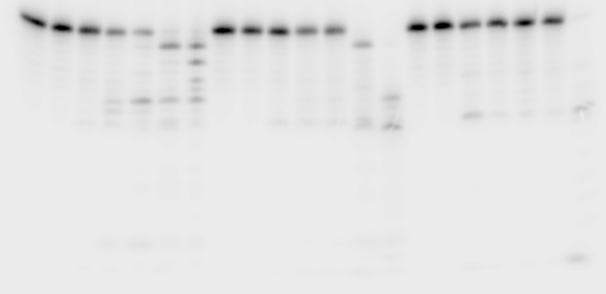
Suppl. Fig. 6C
MgCl₂
MnCl₂
ZnCl₂
- + + + + + + - + + + + + + - + + + + + + 250 nM CDIN1-Codanin-1
10 0 0.5 1 2 5 10 10 0 0.5 1 2 5 10 1 0 0.05 0.1 0.2 0.5 1 mM ions
Radiolabelled

Slide 6
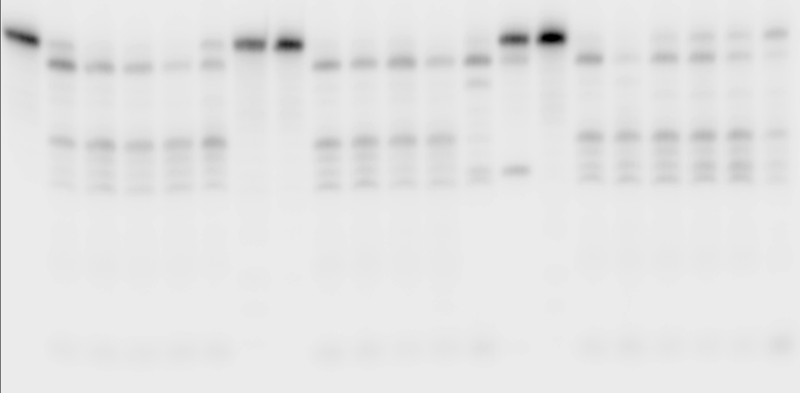
Suppl. Fig. 6D
EDTA
EGTA
o-phenanthroline
- + + + + + + - + + + + + + - + + + + + + 250 nM CDIN1-Codanin-1
10 0 0.5 1 2.5 5 10 10 0 0.5 1 2.5 5 10 10 0 0.5 1 2.5 5 10 mM chelators
Radiolabelled

Slide 7
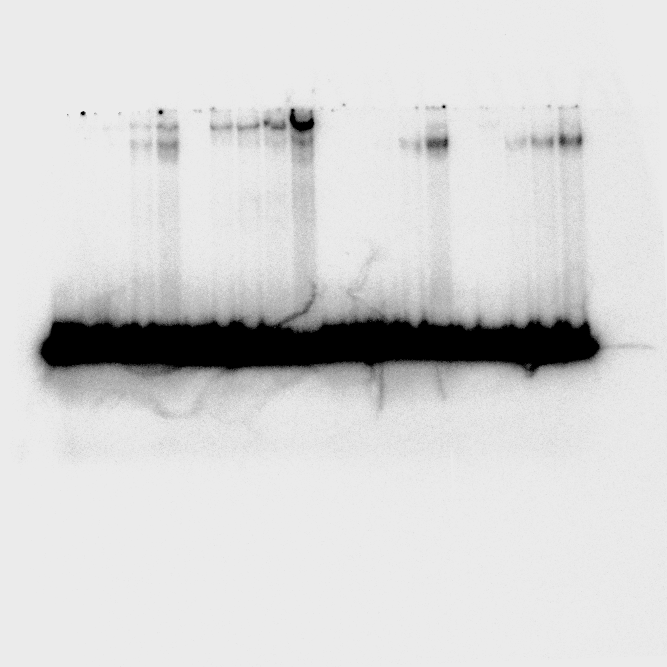
Suppl. Fig. 7C
Radiolabelled

Slide 8
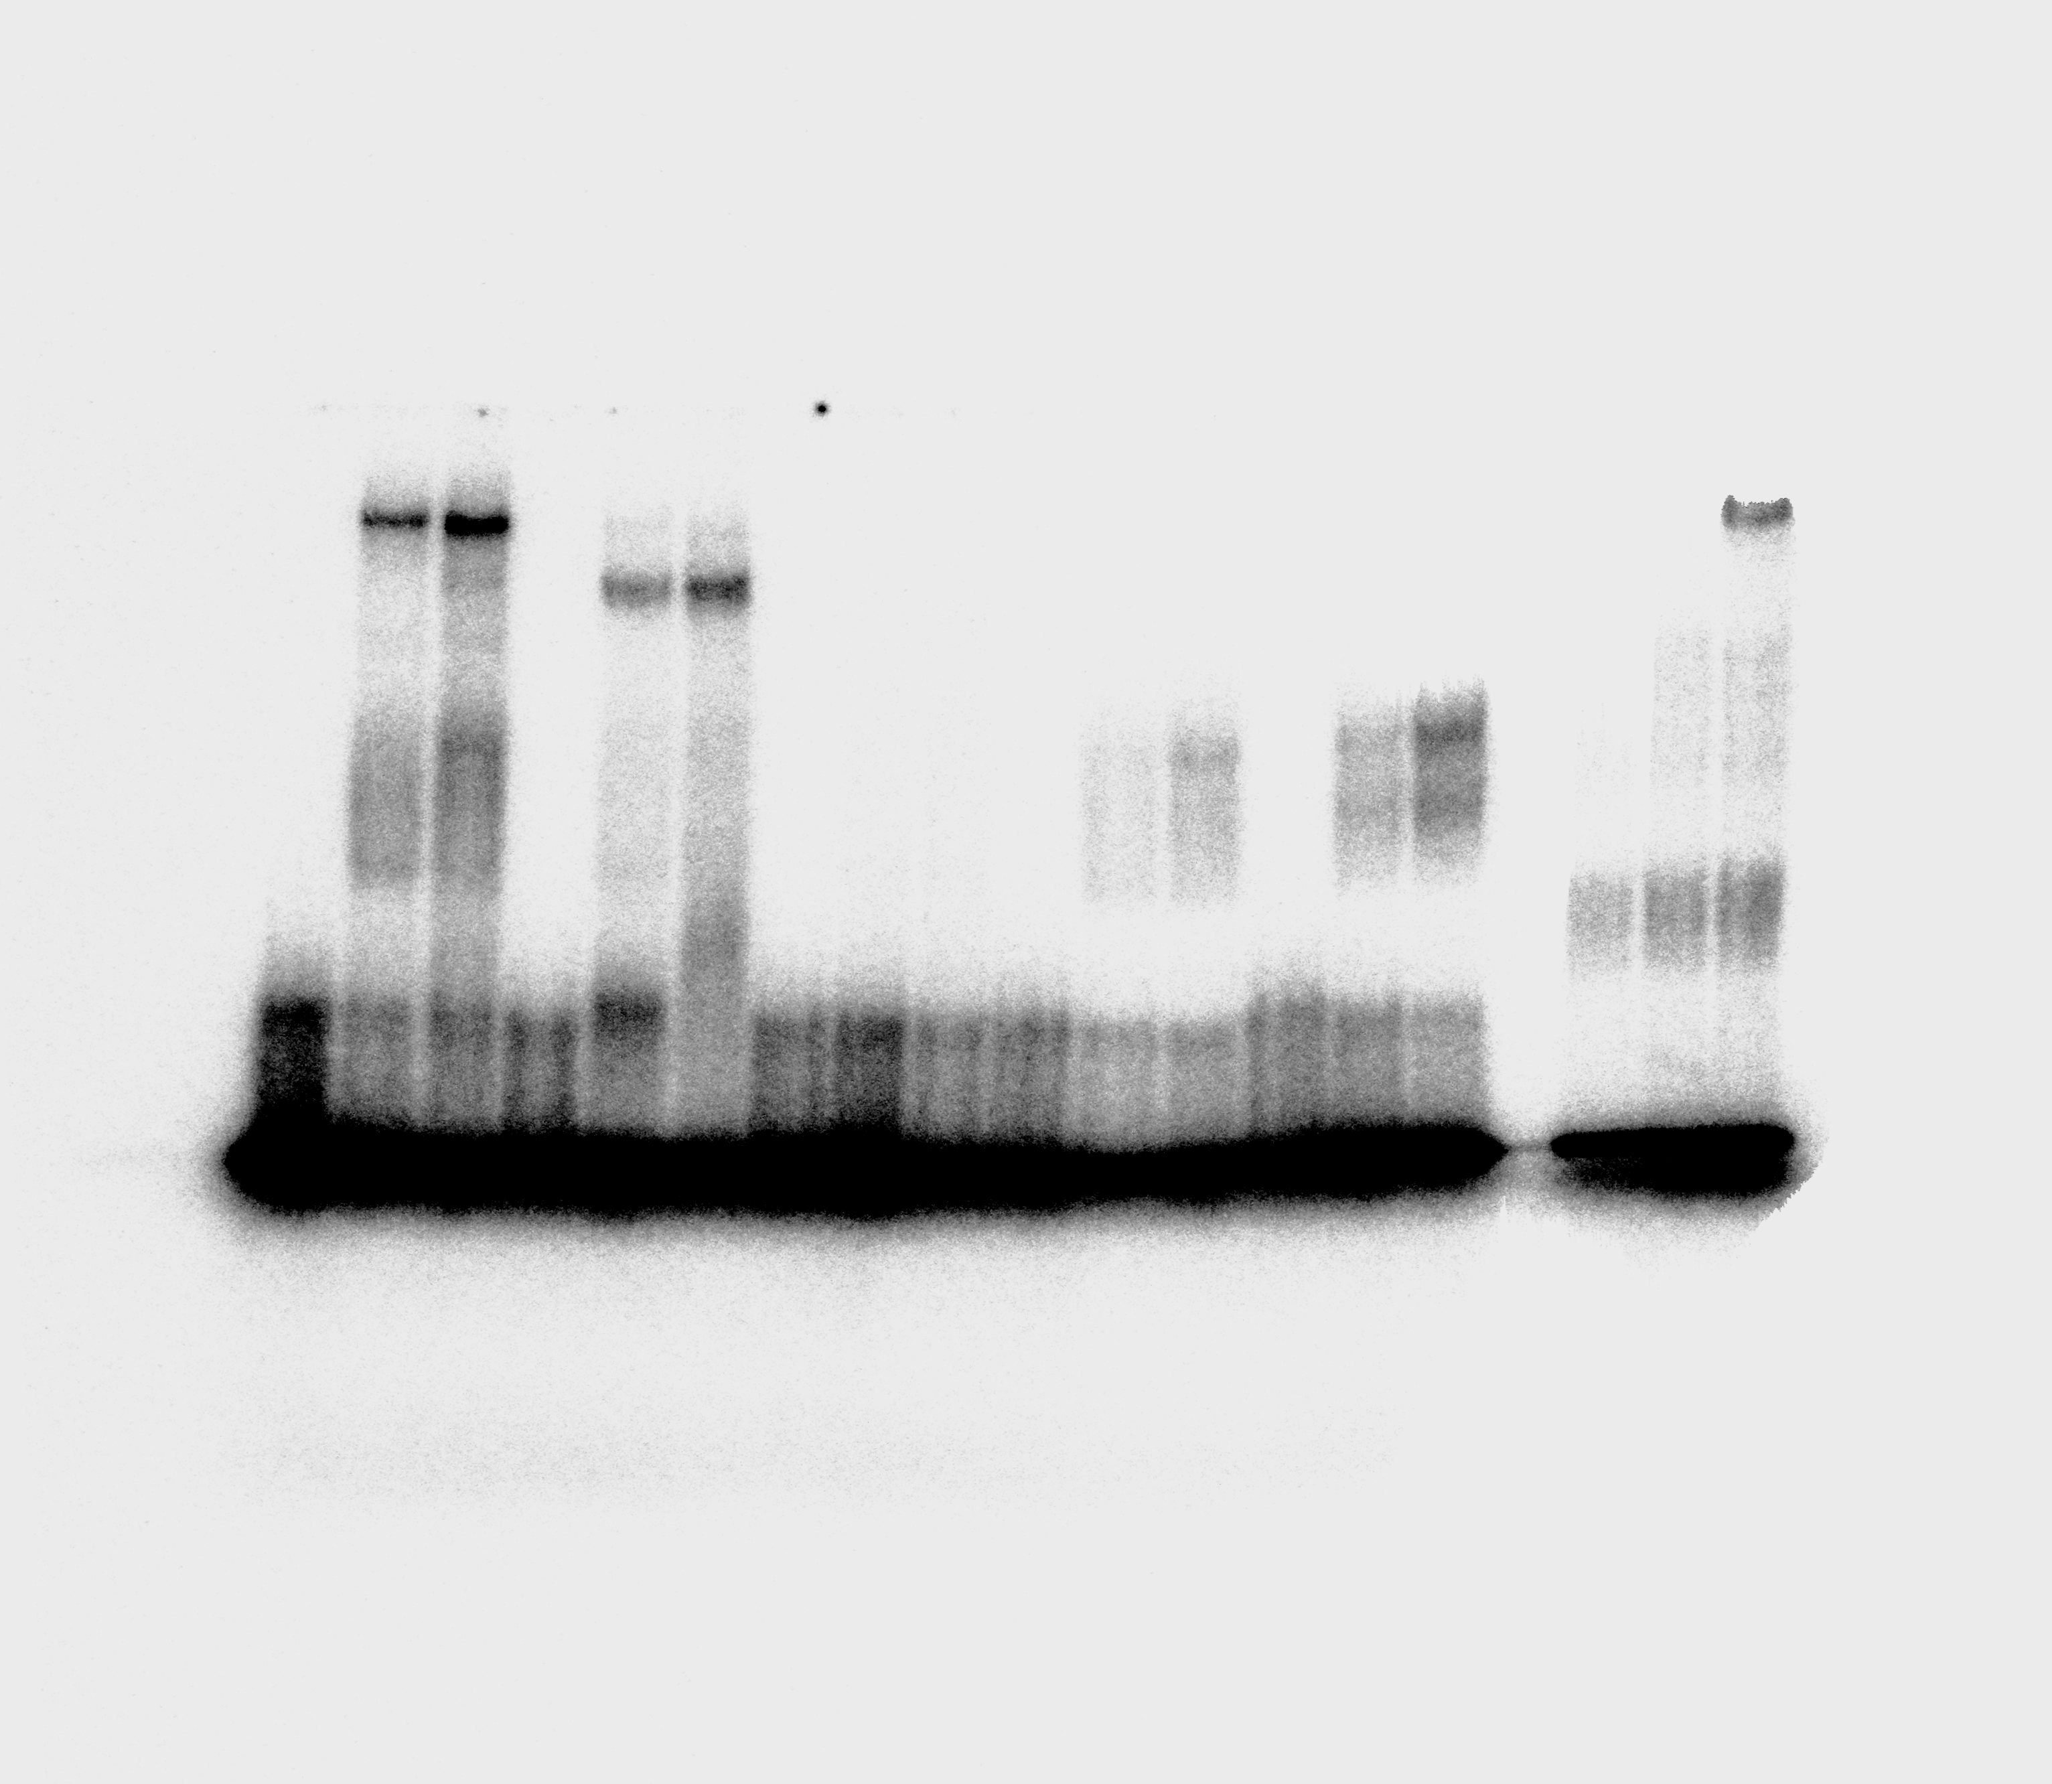
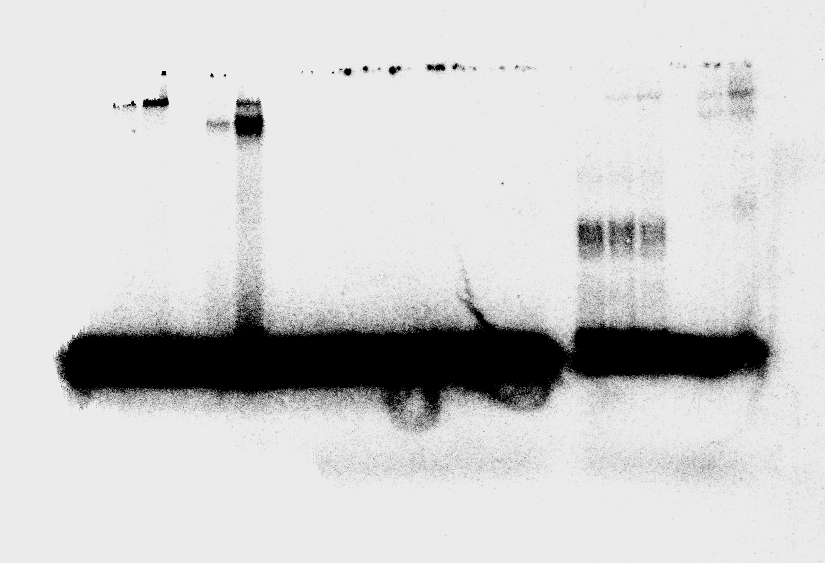
Suppl. Fig. 7C
dsDNA
5’
ssRNA
0 500 nM CDIN1-Codanin-1
0 500 nM CDIN1
Codanin-1
Radiolabelled

Slide 9
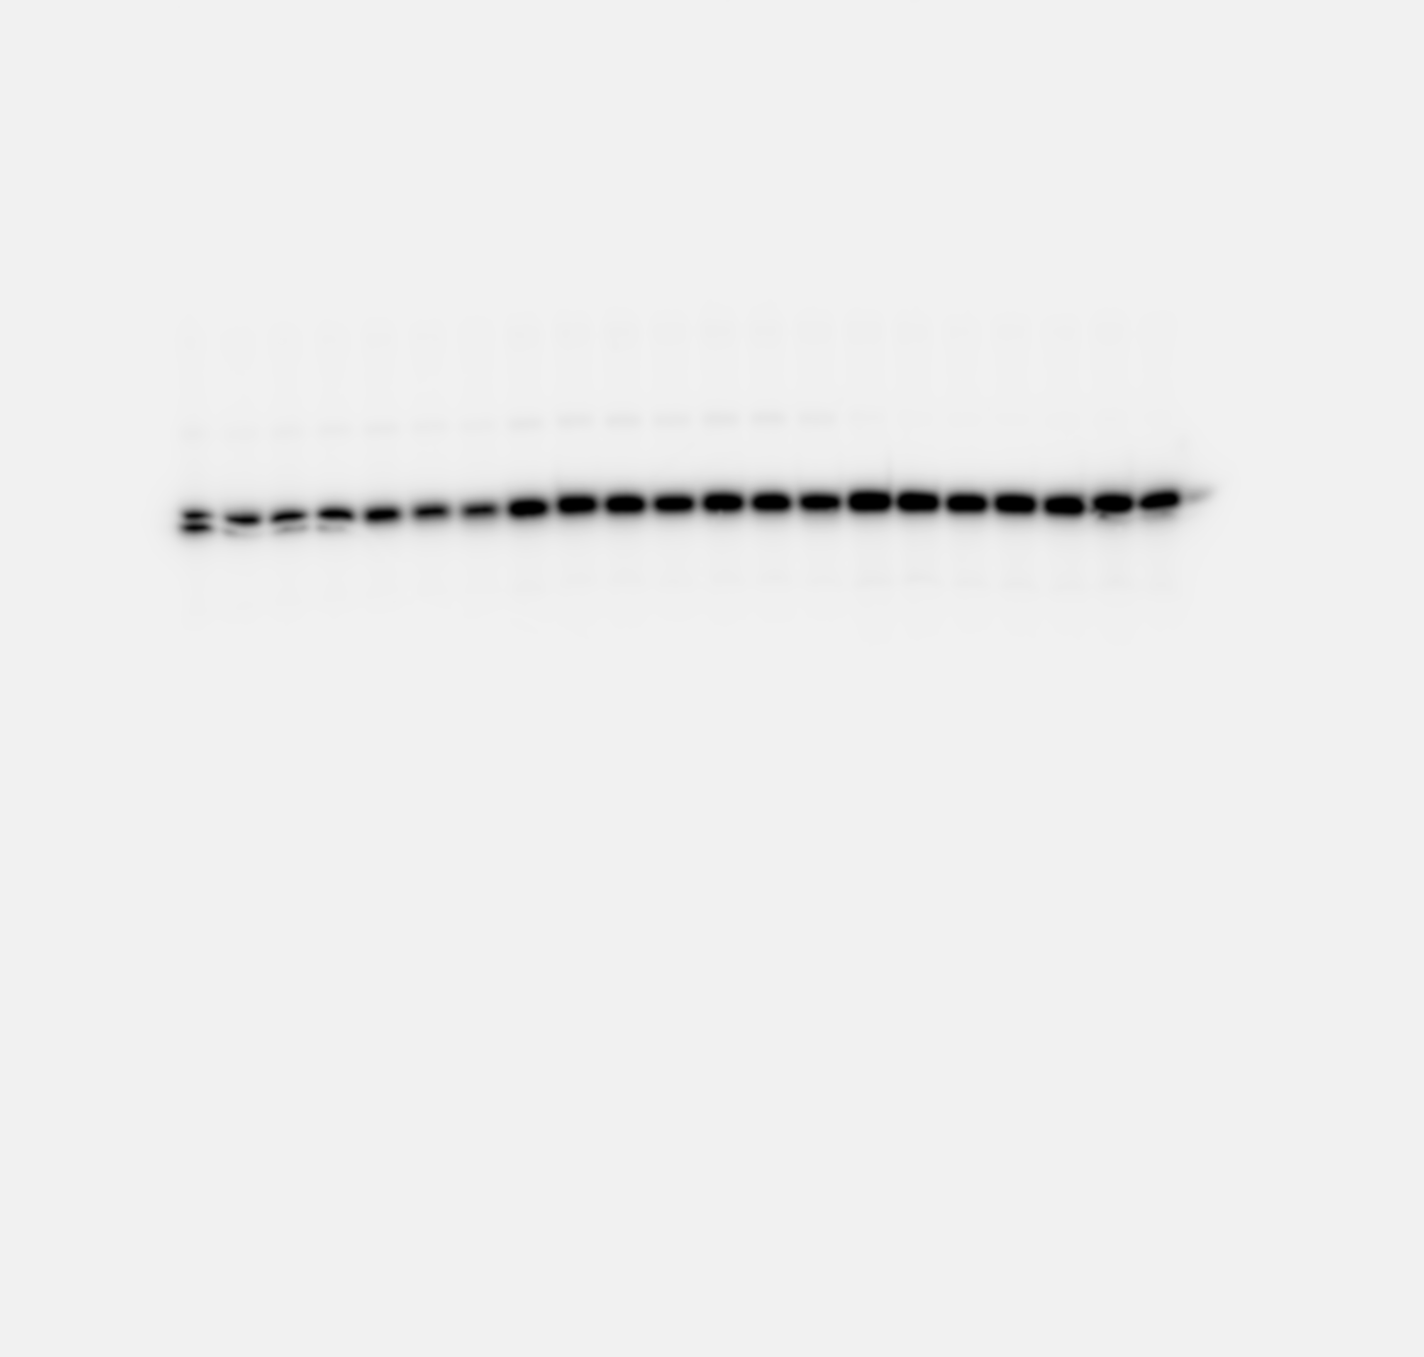
Suppl. Fig. 7D
Fork
5’
0 5000 0 5000 nM CDIN1-Codanin-1
Radiolabelled

Slide 10
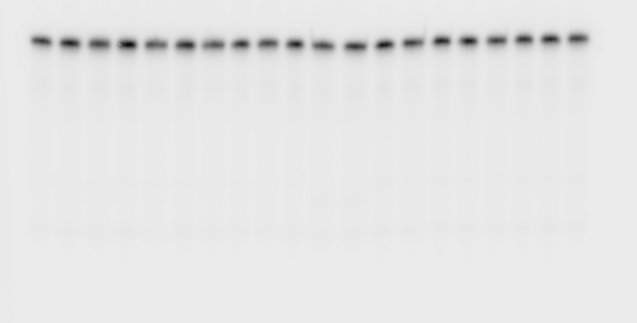
Suppl. Fig. 8F
D-loop
ssDNA
DNA*-DNA
5’
5’
5’
0 500 0 500 0 500 nM CDIN1-Codanin-1
Radiolabelled

Slide 11
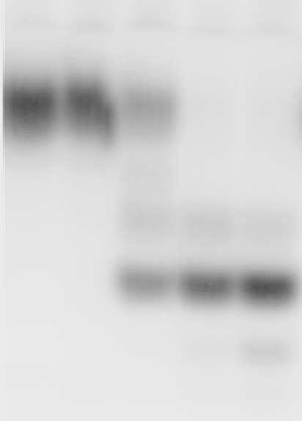
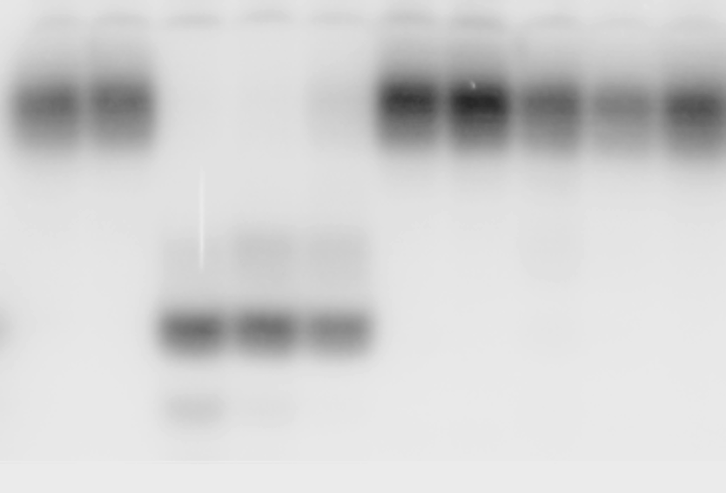
Suppl. Fig. 8E
R-loop
ssRNA
RNA*-DNA
5’
5’
5’
0 500 0 500 nM CDIN1-Codanin-1
0 500 nM CDIN1-Codanin-1
Radiolabelled

Slide 12
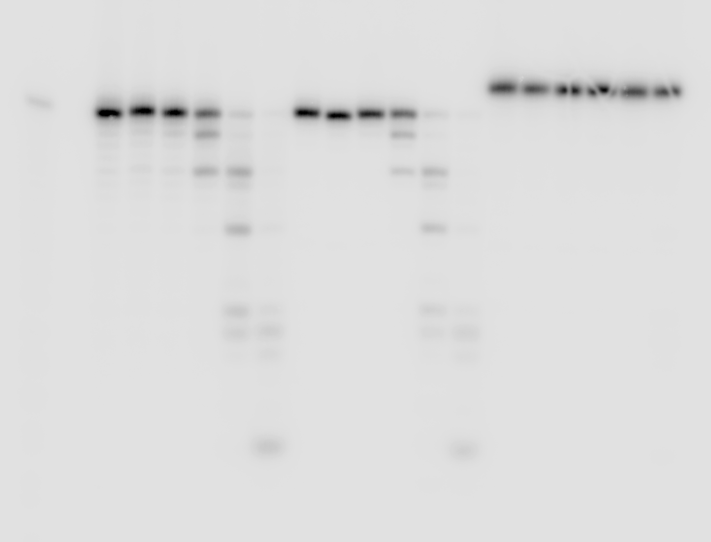
Suppl. Fig. 8D
ssRNA
ssRNA
ssRNA
5’
OH
5’
P
5’
Biotin
0 1 0 1 0 1 Units of Exonuclease T
Radiolabelled

Slide 13
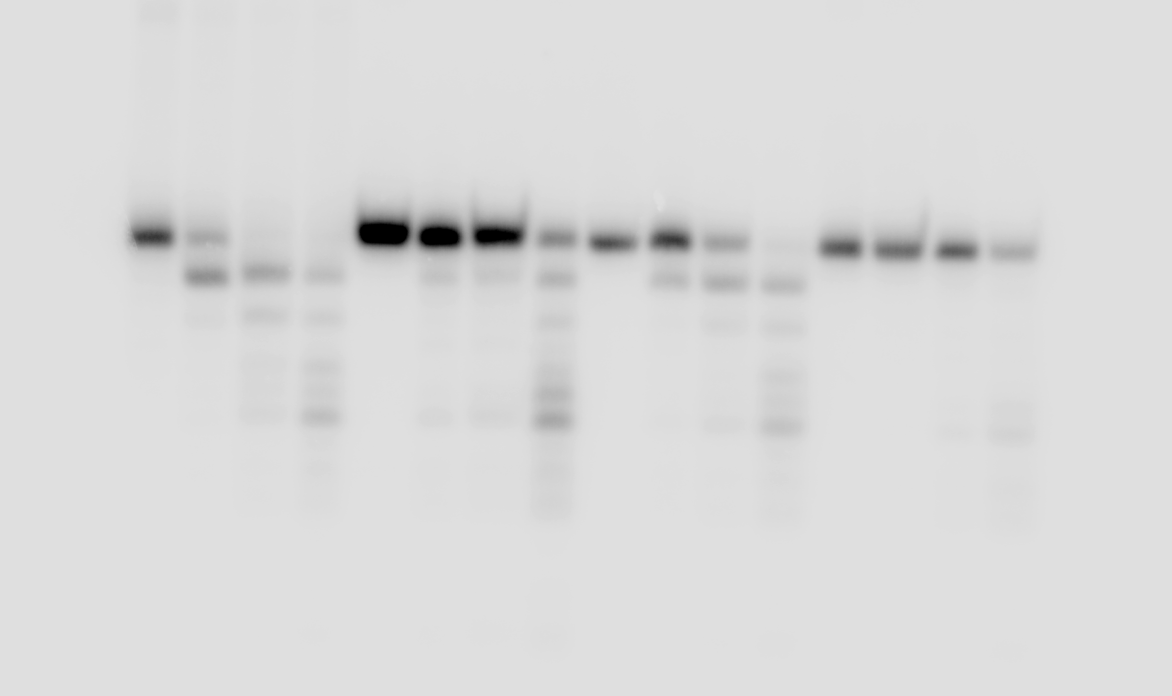
Suppl. Fig. 8C
RNA-DNA
RNA-DNA
RNA-DNA
RNA-DNA
5’
5’
m²A
5’
H₃C
5’
A
A
I
CH₃
m⁶A
Inosine
0 500 0 500 0 500 0 500 nM CDIN1-Codanin-1
Radiolabelled

Slide 14
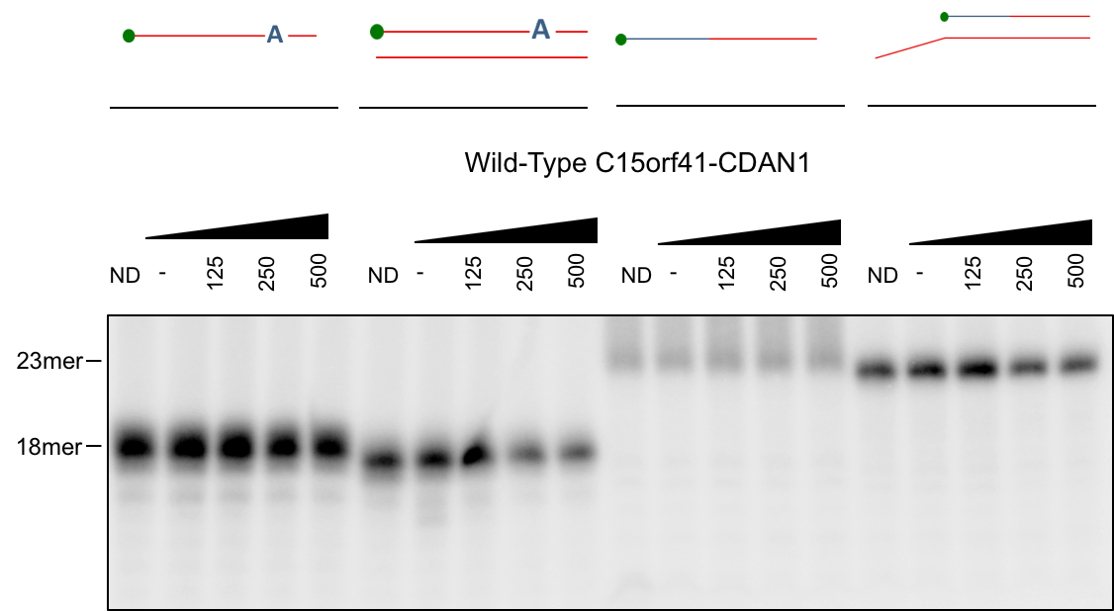
Suppl. Fig. 8A and B
‘Okazaki-like’ fragment
Embedded ribonucleotide
Embedded ribonucleotide
RNA
DNA
5’
5’
A
5’
A
5’
10 mer
13 mer
0 500 0 500
0 500 0 500 nM CDIN1-Codanin-1
Radiolabelled

